Slide 1
System request
project sponser | : Eng Ahmed Madkour
Business need | : 1-software system for take the attendance and absence of doctors and nurses.
Requriement: | 1. Provide online access 2. Count the number of patients on a daily basis 3. Determine when to change roles 4. More usable
Value: | 1.Reduce 5% of total cost 2.Project personnel will be treated for two years free of charge
Special issues: | 1. no enternet 2. no computer enough 3. Electricity problem.

Slide 2
Feasability Study
Feasability study
1. Technical Feasibility | Assess the technology required for the system (e.g., web-based, mobile app, or a combination). Evaluate the availability of required hardware and software. Check if the project aligns with the organization's technical capabilities
2. Operational Feasibility: | Evaluate how the system will integrate with existing processes and workflows. Assess the impact on daily operations during the implementation phase. Ensure that the system is user-friendly and easy to adopt.
3. Economic Feasibility | Estimate the overall cost of developing and implementing the software. Compare costs with potential benefits, including time savings and increased efficiency. Consider the return on investment (ROI) over the long term
4. Schedule | .Ability to create, edit, and view schedules for doctors and nurses. Support for regular working hours, on-call shifts, and special assignments Automated scheduling with consideration for staff preferences and constraints.

Slide 3
Project Plan
Methodology
In this level I use waterfall in my project because It's easy no To arrange information and stages
Methodology | Task Identification | Time Estimation

Slide 4
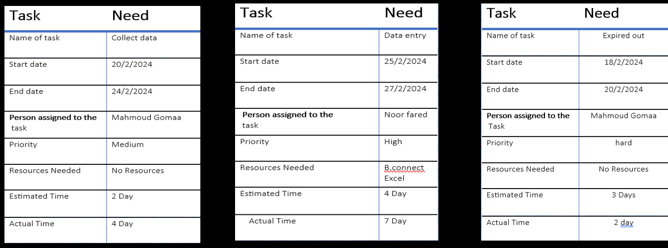
Task Information
basil
basil
ahmd

Slide 5
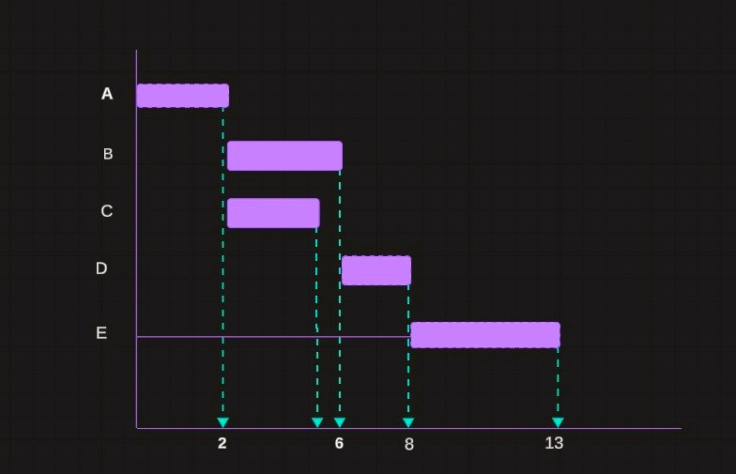
GANT CHART
GANT CHART

Slide 6
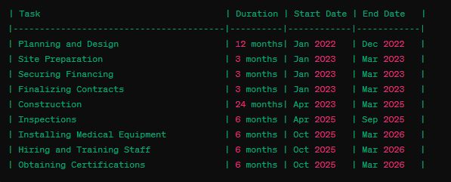
PERT CHART
PERT CHART

Slide 7
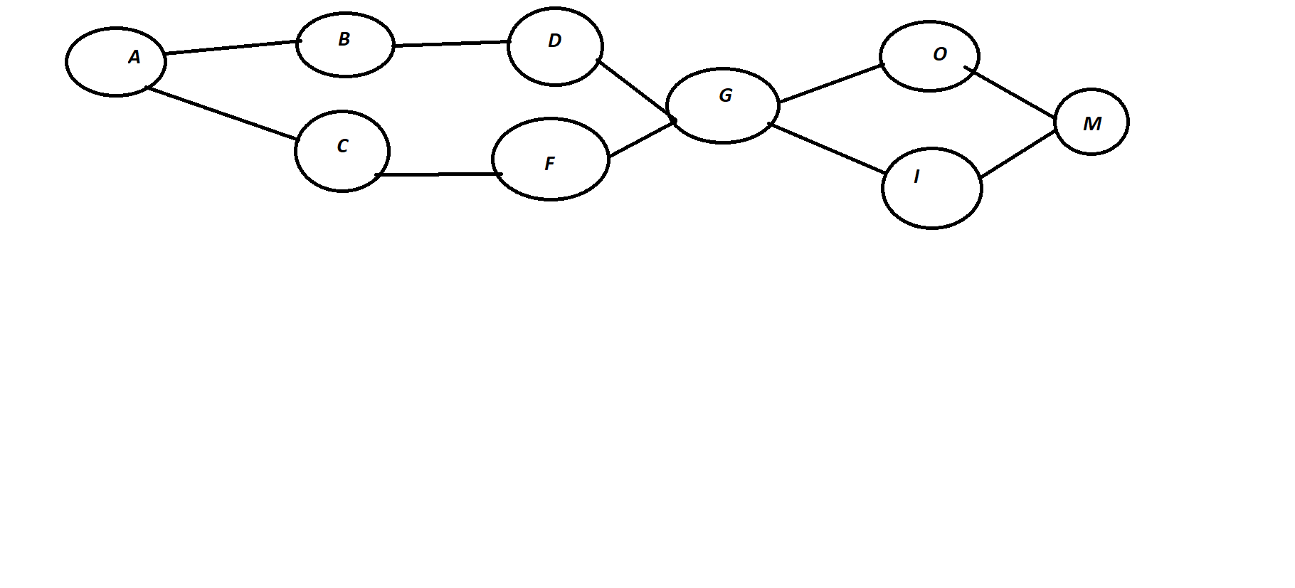
PERT CHART

Slide 8
System development life cycle
About hospital
Planning
Analysis
Design
Development

Slide 9
Systems Development Life Cycle (SDLC)

Slide 10
Basil
Basil
Ahmed
Ahmed
Ahmed
Basil
Ahmed
Basil
Basil

Slide 11
INTERVIEW
Interview report about eldawly hospital in Mansoura
Hospital: Eldawly
Date of interview: 5/3/2024
*purpose: To gather information about the hospital's services, patient experience, and overall operations.
Interviewer: ahmed mohamed
*Methodology: Interviews were conducted with the following personnel:
Mr. (ali), Physician
Mr. (ahmed), Nurse
Dr. (ahmed), doctor
Introduction:
This report details an interview conducted at [Eldawly hospital] on [5/3/2024] to gather information about the hospital's operations and services. The interviewee was [ahmed ,ali ]. The purpose of the interview was to gain a deeper understanding of the hospital is:
Patient care procedures
Available departments and specialties
Patient intake and discharge processes
Technology and resources utilized
Overall patient experience

Slide 12
*Key finding:
After some interviews with some doctors and nurses I concludes some informations
*The advantage of the hospital:
-inspection for a nominal fee
-the medical team adheres to working hours
-there are all specialties in this hospital
-the hospital is near to the city and the village
*the disadvantage of the hospital:
-Lack of availability of some medications
-lack of sufficient beds for patients
-lack of higlhly efficient devices
*summary of interview:
Generally hospitals in Egypt are very suitable for anyone but not the best and government are interested of them and want to cover all disadvantage
*In conclusion:
State a simple, overall assessment of the hospital based on the information gathered. (e.g., The hospital appears to be well-equipped with a dedicated staff, but streamlining communication channels could further enhance patient experience.)
Mention any further steps needed. (e.g., A follow-up interview to delve deeper into specific areas might be beneficial.)

Slide 13
Interview Report
Person interviewed | Ahmed ,wael, Hussien
Interviewer | Ahmed
Purpose of interview | Collect data about this hospital
Summary of interview | After some interviews with some doctors and nurses I concludes some information *The advantage of the hospital: -inspection for a nominal fee -the medical team adheres to working hours -there are all specialties in this hospital -the hospital is near to the city and the village *the disadvantage of the hospital: -Lack of availability of some medications -lack of sufficient beds for patients -lack of higlhly efficient devices
Open items

Slide 14
*context diagram
Staff
Add Master Record
Hospital reprts
Create staff account
Hospital
Management
System
Discharge bill
Patient
Adminstrator
reports
payment
Context level DFD for Hospital Management System

Slide 15
Context level dfd – 0 level
The context level of DFD is describe the whole system. It shows the all user module who operate the system The hospital managment system dfd shows there is only user hospital admin staff to run the system.

Slide 16
Context level dfd – 0 level
Hospital Management System
Login
Hospital staff
Response

Slide 17
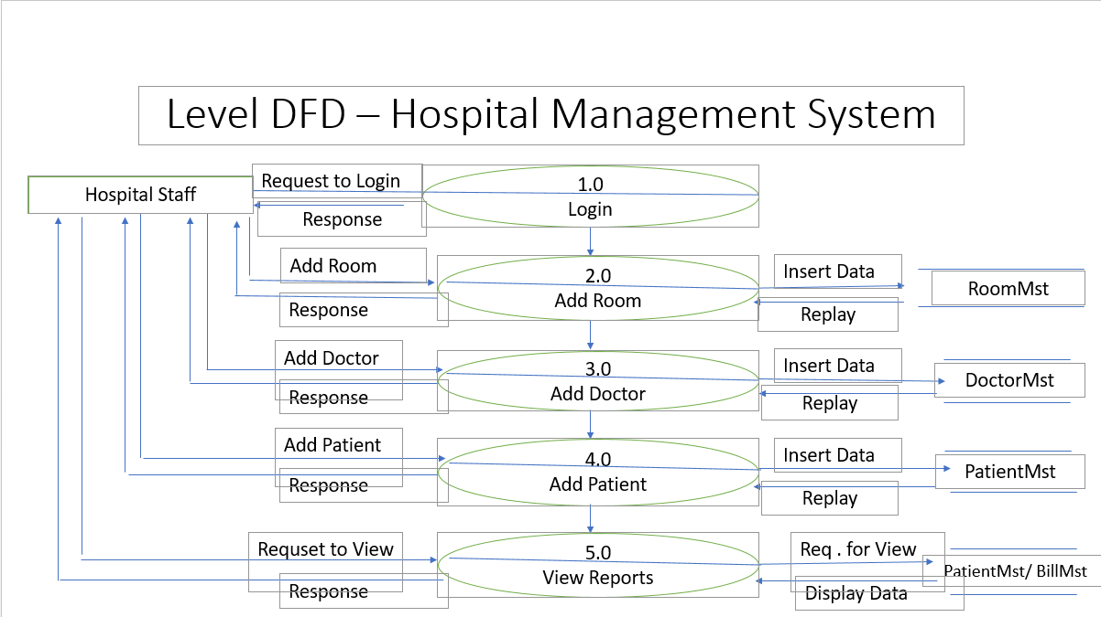
LEVEL 1 DFD

Slide 18
Process Specification
Process Specification Number: 1 Name: Login Description: enable anyone of the staff to login
Input Data Flow Request to login from entity hospital staff
Output Data Flow Response
Type of Process Online Batch Manual
Process Logic:
Structured English Decision Table Decision Tree

Slide 19
Process Logic – Structured English
Start of process
1- start to log in to the system of hospital
Doctors,nurses
and the patient
End of process

Slide 20
Process Specification
Process Specification Number: 2 Name: Add Room Description: enable the staff to add room to room mst (data base)
Input Data Flow Add room to process add room Replay to process add room
Output Data Flow Insert data to data store room mst Response to entity hospital staff
Type of Process Online Batch Manual
Process Logic:
Structured English Decision Table Decision Tree

Slide 21
Process Logic – Structured English
Start of process
1-book rooms of hospital online or offline
2- save the data
3-storge in database
End of process

Slide 22
Process Specification
Process Specification Number: 3 Name: Add doctor Description: enable hospital staff to add doctor to doctor mst (data base)
Input Data Flow Add doctor to process add doctor Replay to process add doctor
Output Data Flow Insert data to data store doctor mst Response to entity hospital staff
Type of Process Online Batch Manual
Process Logic:
Structured English Decision Table Decision Tree

Slide 23
Process Logic – Structured English
Start of process
1-doctors names add to the data base
2-start process all data in database
3-give the okay for database
End of process

Slide 24
Process Specification
Process Specification Number: 4 Name: Add patient Description: enable hospital staff to add patient to patient mst (data base)
Input Data Flow add patient to process add patient Replay to process add patient
Output Data Flow Insert data to patient mst data store Response to entity hospital staff
Type of Process Online Batch Manual
Process Logic:
Structured English Decision Table Decision Tree

Slide 25
Process Logic – Structured English
Start of process
1- doctors check some patients
2- some other patients wait for doctors
End of process

Slide 26
Process Specification
Process Specification Number: 5 Name: view Reports Description: enable hospital staff to display any data
Input Data Flow Request of view to process view reports Display data to process view reports
Output Data Flow Request for view to data store patient Mst/ bill Mst Response to entity hospital staff
Type of Process Online Batch Manual
Process Logic:
Structured English Decision Table Decision Tree

Slide 27
Process Logic – Structured English
Start of process
1-All data store in data base
End of process

Slide 28
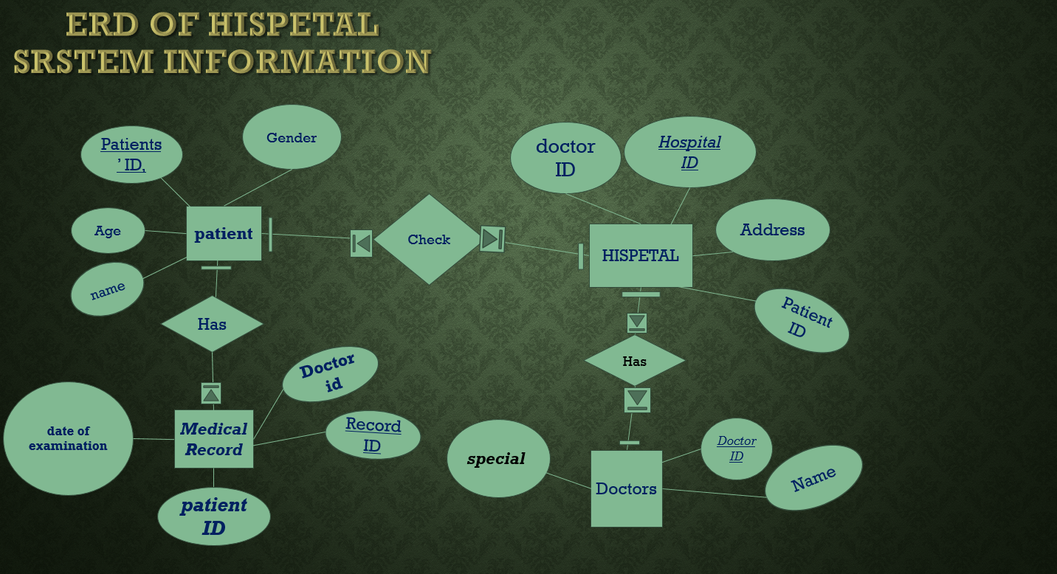

Slide 29
normalization
Next page

Slide 30
Patients’ ID | name | Gender | Age
1 | Noor | M | 19
2 | Ahmed | M | 20
3 | Khalid | M | 30
4 | Mostafa | M | 50
5 | Mostafa | M | 50
6 | Ali | M | 26
7 | Amira | F | 26
Patient table
Hospital ID | Address | doctor ID | Patient ID
1005 | Tanta | 102 | 1
1005 | Tanta | 103 | 2
1005 | Tanta | 104 | 3
1005 | Tanta | 105 | 4
1005 | Tanta | 105 | 5
1005 | Tanta | 106 | 6
1005 | Tanta | 106 | 7
Hospital table

Slide 31
Record ID | Doctor id | patient ID | date of examination
8 | 102 | 1 | Conjunctivitis
9 | 103 | 2 | Atherosclerosis
10 | 104 | 3 | Orthopedic surgeon
11 | 105 | 4 | Cavities
11 | 105 | 5 | Cindivities
12 | 106 | 6 | Sinusitis
12 | 106 | 7 | Allergic Rhinitis
Medical record
table
Doctor ID | Name | spcial
102 | Ahmed | eyes
103 | Sayed | Heart
104 | Khalid | Surgery
105 | Ibrahim | dentist
105 | Ibrahim | Dentist
106 | Basel | Nose
106 | Hatem | Nose
Doctors table

Slide 32
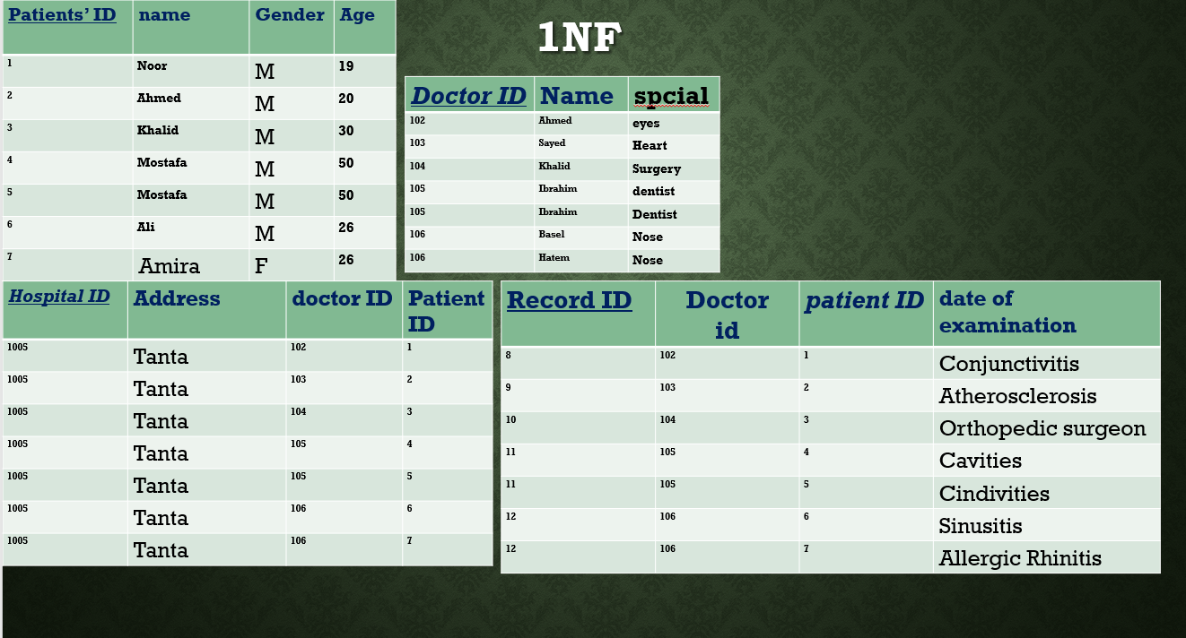

Slide 33
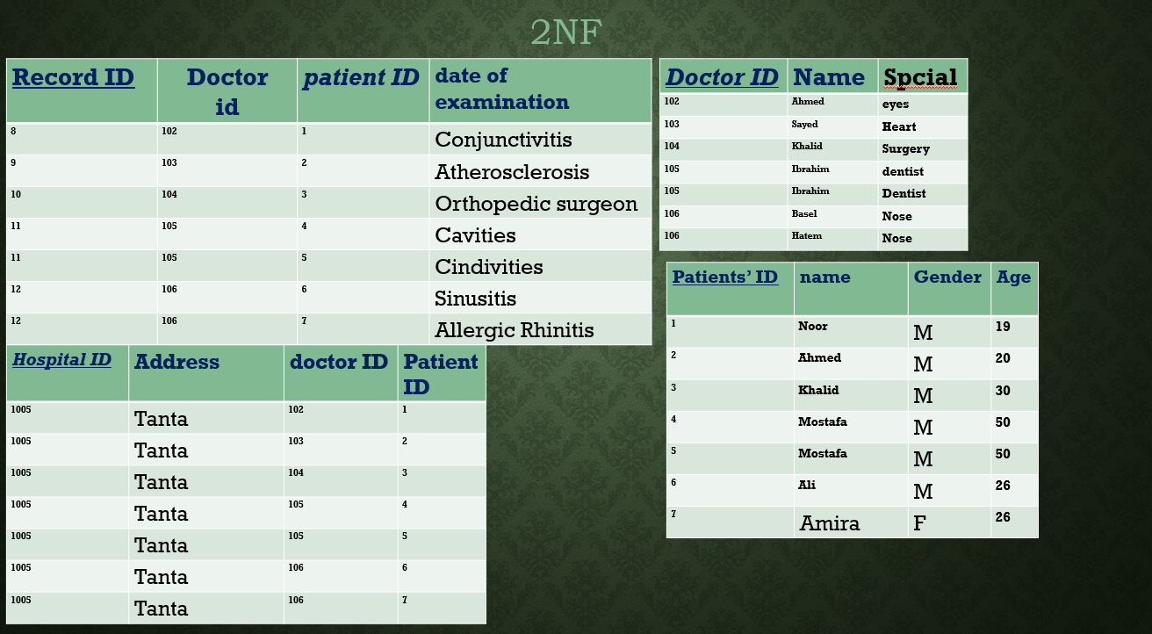

Slide 34
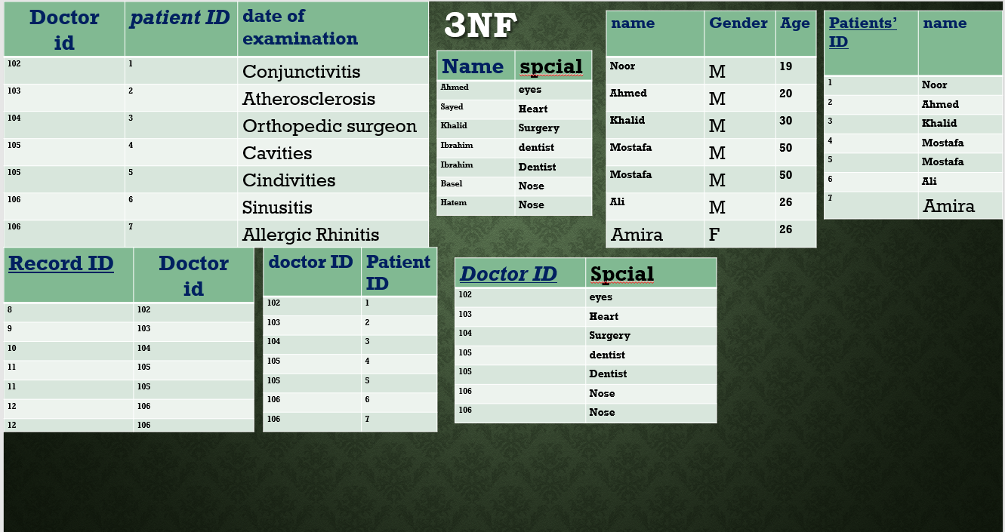

Slide 35
ERD after Normalization
Next page

Slide 36
